Slide 1
Machine Learning
Machine Learning Introduction to Machine Learning by Kumar Anurupam is licensed under a Creative Commons Attribution-4.0 International License.
Introduction to Machine Learning
CS 3104 Fall 2019
Lecture Slides by Kumar Anurupam

Slide 2
Learning Outcome
After the completion of today’s session you will be able to:
Define Machine Learning.
List the application of Machine Learning.
Explain the need of Machine Learning.

Slide 3
Why Machine Learning?
AI is not enough now.
Utilizing all the capabilities of a computer to accomplish tasks easily.
Solving complicated real world problems with ease.
Not dependent on programmed machines but rather on machines which learn by experience.
Deep Learning is about to supersede Machine Learning.

Slide 4
Application areas of Machine Learning
ML
Travel
Healthcare
Finance
Retail
Manufacturing
Recommendation systems
Natural Language Processing
Computer vision
Data Mining

Slide 5
What is Machine Learning?
Arthur Samuel, 1959, [Machine Learning is the] field of study that gives computers the ability to learn without being explicitly programmed.[1]
Motivation: Checkers Learning Problem
Tom Mitchell, 1997, A computer program is said to learn from experience E with respect to some task T and some performance measure P, if its performance on T, as measured by P, improves with experience E.[2]

Slide 6
Some learning problems
1. Checkers Learning Problem
Task T: Playing checkers.
Performance measure P: Percent of games won against opponents.
Training experience E: Playing practice games against itself.

Slide 7
Some learning problems – contd…
2. Spam Filter Problem
Task T:
Performance measure P:
Training experience E:

Slide 8
Some learning problems – contd…
3. Handwriting Recognition Learning Problem
Task T: Recognition and Classification of words within images.
Performance measure P:
Training experience E:

Slide 9
Some learning problems – contd…
4. Robot Driving Learning Problem
Task T:
Performance measure P:
Training experience E:

Slide 10
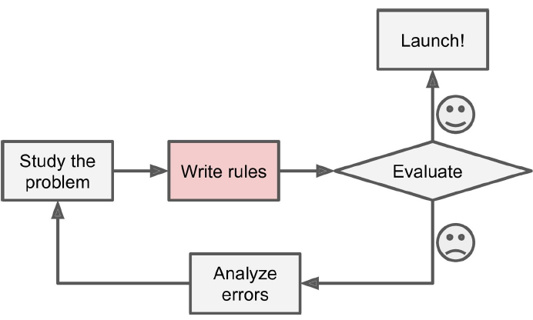
How to use Machine Learning?
The Traditional Approach [3]

Slide 11
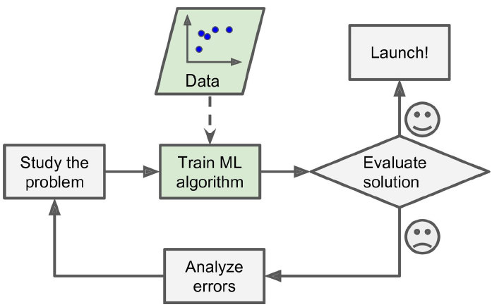
How to use Machine Learning? – contd…
The Machine Learning Approach [4]

Slide 12
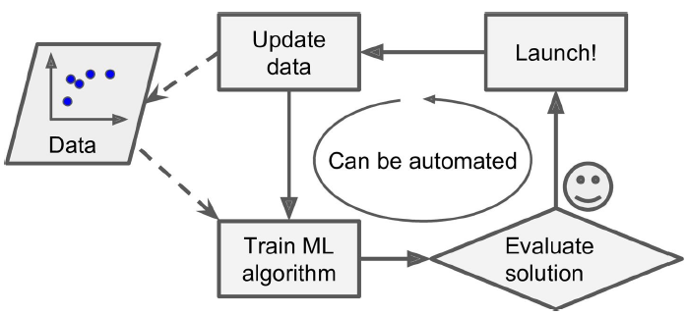
How to use Machine Learning? – contd…
Automatically Adapting to change [5]

Slide 13
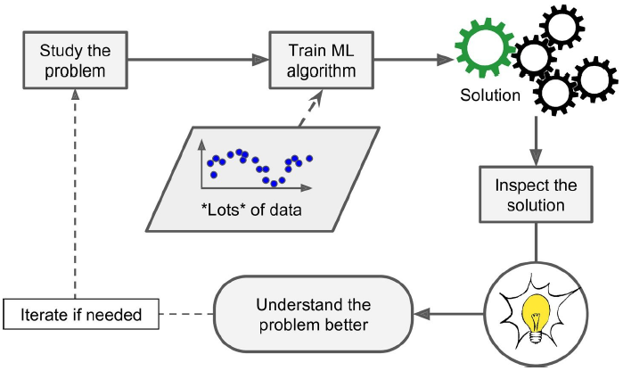
How to use Machine Learning? – contd…
Human Learn through machine learning [6]

Slide 14
Summary
Machine Learning focus on machines which learn by experience.
Machine Learning is field of study that gives computers the ability to learn without being explicitly programmed.
A computer program is said to learn from experience E with respect to some task T and some performance measure P, if its performance on T, as measured by P, improves with experience E.
ML can be used in almost all the areas of society.

Slide 15
References
[1] Samuel, Arthur L.. “Some Studies in Machine Learning Using the Game of Checkers.” IBM Journal of Research and Development 3 (1959): 210-229.
[2] Mitchell, Tom M.. Machine Learning. New York: McGraw-Hill, 1997
[3,4,5,6] Aurelien Geron, “Hands-On Machine Learning with Scikit-Learn & TensorFlow” O Reilly

Slide 16
Thanks

